Slide 1
Generative Text

Slide 2

This Week’s Agenda
AI News
Generative Language Models
Machine translation
Large language models
Auto-regressive (large) language models
Pre-trained LLMs
LLM + RAG

Slide 3
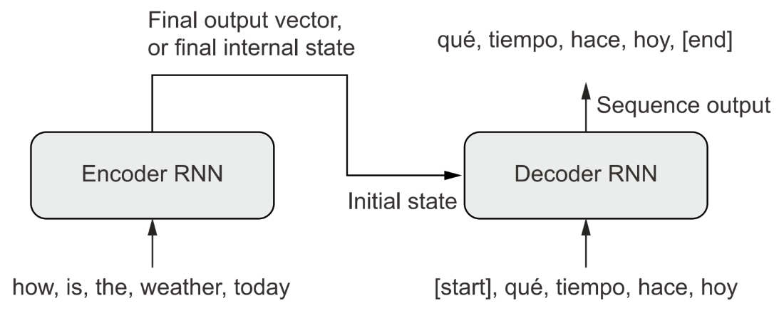
Machine Translation: Encoder-Decoder
Similar Idea with Some Additions
Include an ‘encoder’ that first processes the entire input sequence to obtain an embedded representation of the input text.
We are not just generating ‘plausible’ text now; we are generating plausible text that aligns with (i.e., conditioned upon) the input text.
Our encoder can be bidirectional, but our decoder must be unidirectional. Why?
Notes:
If we have a bidirectional decoder, it will read ahead in the target sentence and cheat, using information that will not present at inference! There won’t be any error messages, but the model is essentially learning how to operate under the presence of information that will never be present in its sequence embeddings for the output generated thus far.

Slide 4
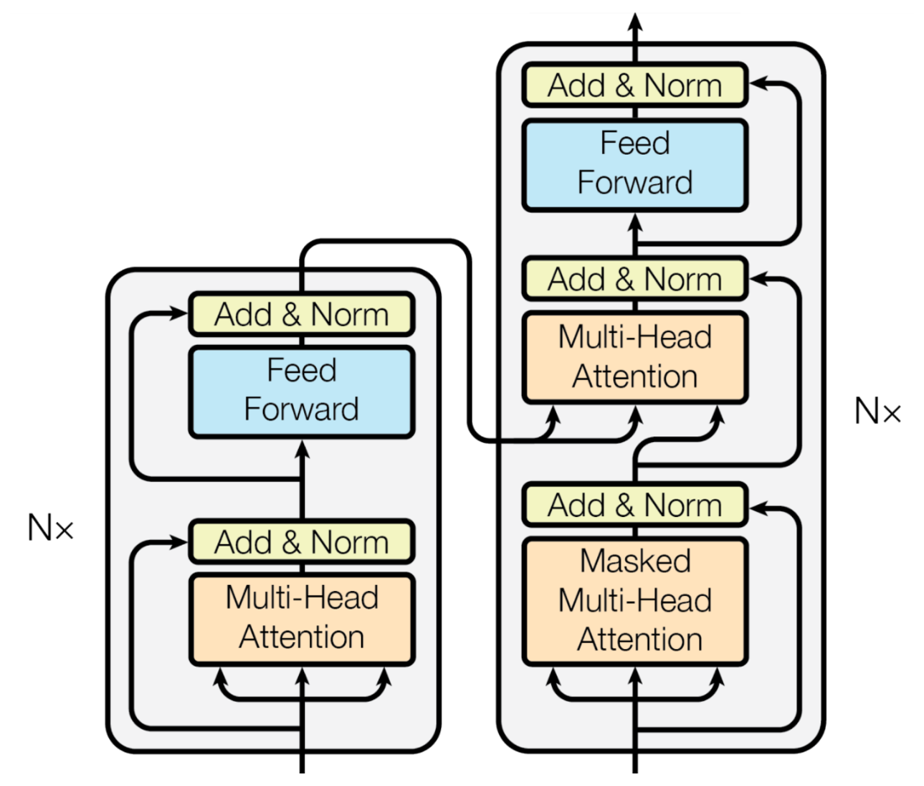
Encoder-Decoder with Transformers
Replace RNNs with Transformers
Transformers are an architecture that wraps MultiHeadAttention(). We have some residual connections inside and some LayerNormalization() operations, with a couple of Dense layers on the output.
We also need to create a special masking layer to prevent the Transformer from looking ahead in the target sequence.
Our decoder uses cross-attention. It compares the representation of the Spanish output seen thus far to the entire English sequence representation.
Notes:
Encoder is on the left and Decoder is on the right. Our Encoder learns attended representations of the English input sequence. Our decoder uses cross-attention to compare an attended representation of the Spanish output seen so far with the input attended English sequence, to decide what to spit out next.

Slide 5
Translation with Self- and Cross-Attention
1. First, Self-Attention in Spanish Sequence (words output so far), i.e., with masking.
2. Second, Self-Attention in English Sequence (entire sequence).
3. Finally, Cross-Attention Comparison.
Query: The attended representation of the Spanish sequence (generated so far) acts as the query. "Given what I've generated in Spanish already, what information from the English sentence is most relevant to predicting the next word?”
Key and Value: The attended representation of the entire English sentence acts as both the "key" and "value." The "key" is used to compute attention weights (how much each English word should be attended to), and the "value" is the information that gets weighted and incorporated into the Spanish sequence.
4. Apply the Attention Weights to English Representation: The attention weights from comparing the query (Spanish) and key (English) are applied to the value (English). This results in a context vector representing the most relevant information from the English sentence for predicting the next Spanish word.

Slide 6

Multi-Head Attention in Other Text Tasks
BERT Embeddings
Bidirectional Encoder Representations from Transformers.
Employs a similar (self-supervised learning) technique as Word2Vec. Mask 15% of words at random in any given sequence and then try to predict those using the words that are not masked.
Word2vec is nice but yields static (generic) embeddings for a given word. BERT learns context-dependent representations. This can dramatically improve the predictive performance of, say, a text classifier.
Notes:
TRANSITION: We've been looking at attention for generation (translation, next-token prediction). Now let's flip it — what if we use attention not to generate text, but to learn better representations of text? That's BERT.

Slide 7
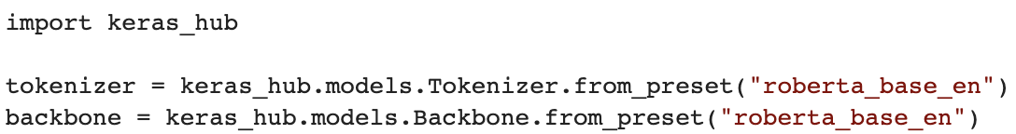
Common Use Case: Sentence Embeddings
Mean Pooling of Contextual Word Embeddings
For a given sentence, you can extract the contextual word embeddings from *after* the MultiHeadAttention layers and then average them.
Pre-Trained BERT Classifier
Or load a pre-trained BERT model’s transformer and embedding layers (backbone / base layers) to pre-process your text and obtain contextual embeddings for a given prediction task.
Or, load the embedding and attention layers, freeze them, and add your Dense layers on top like we did with pre-trained vision models.
Notes:
BERT would also attempt to predict from one sentence whether another appeared next in the original document, to learn sentence-to-sentence relationships.

Slide 8
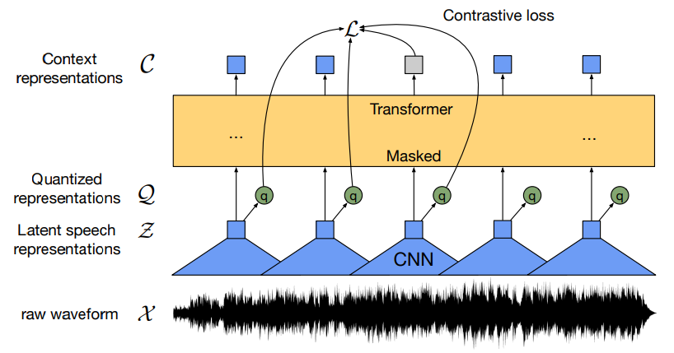
Multi-Head Attention for Audio Representations
Wav2Vec for Audio Understanding
Wav2vec implements a self-supervised learning architecture with random masking of sequence input for audio.
The model first obtains 1D convolutional feature maps per chunk/segment of raw audio signal (spoken words), yielding sequences of feature maps.
A random subsample of feature maps is masked, and the model tries to predict them from the feature maps that remain visible. This model then yields audio embeddings highly representative of spoken semantic content in audio.
Notes:
BERT would also attempt to predict from one sentence whether another appeared next in the original document, to learn sentence-to-sentence relationships.

Slide 9

‘Physics’ Representations from Video
Notes:
BERT would also attempt to predict from one sentence whether another appeared next in the original document, to learn sentence-to-sentence relationships.

Slide 10
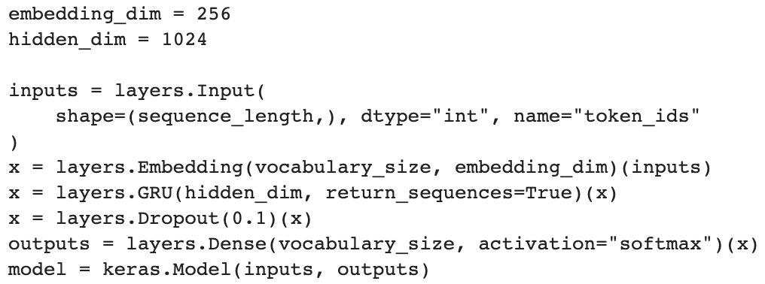
CharRNN: Decoder-Only
Training a Generative Language Model
We train a model to predict the next token at every position in a sequence of observed input tokens.
We will not use this exact model for inference; we will modify it slightly and add a feedback loop to make auto-regression possible.

Slide 11
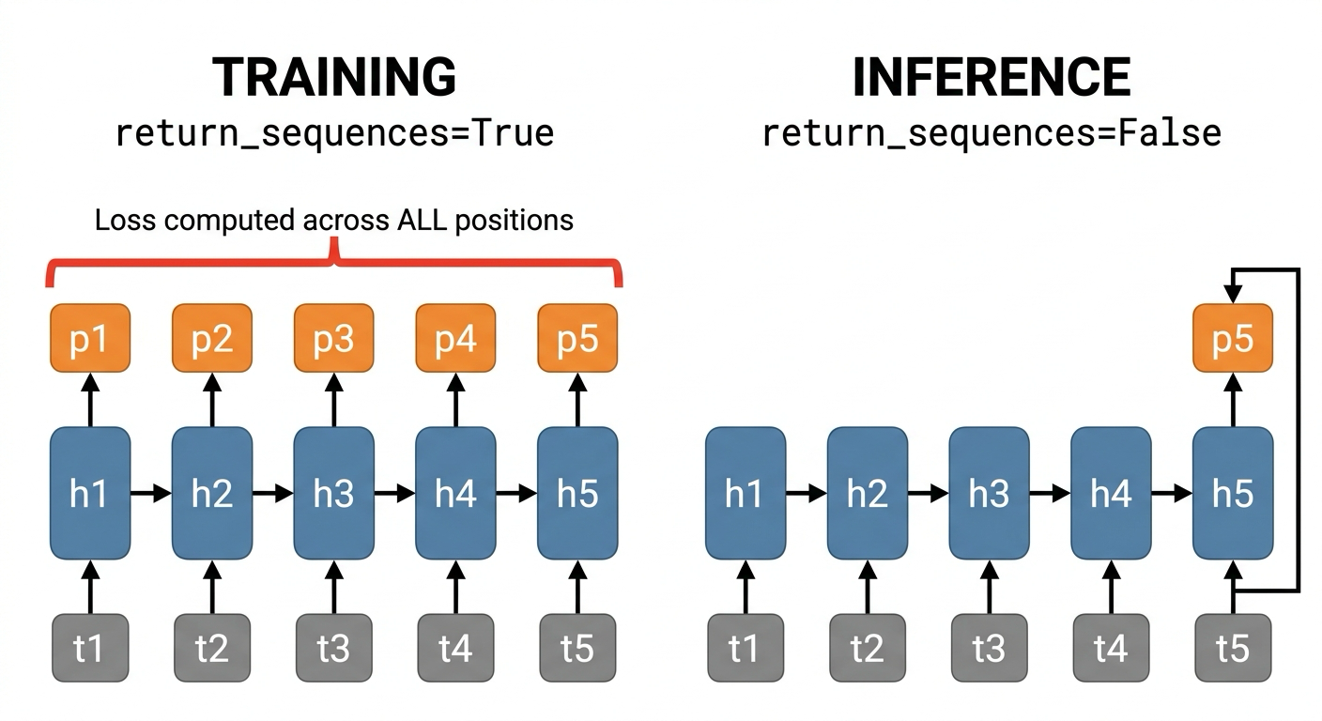
In Training: Loss at Each Sequence Position
Training: Predict All Positions in Parallel
During training, we already know the full sequence. So, we compute loss at every position simultaneously. This is purely an efficiency trick — it does not mean the model "sees the future." Our model predicts one prediction per token in the sequence, in parallel.
Example (character-level):
Position 0: model sees [S] → predicts 'h'
Position 1: model sees [S, h] → predicts 'a'
Position 2: model sees [S, h, a] → predicts 'k'
Position 3: model sees [S, h, a, k] → predicts 'e'
Position 4: model sees [S, h, a, k, e] → predicts 's'
All 5 predictions happen in ONE forward pass, together. Loss = average of all 5 cross-entropy values.
Inference: One Token at a Time
At inference, we set return_sequences = False. We generate one token only, feed it back as input, and repeat. Same weights, just a different loop.
Notes:
Note: we do something similar with a transformer. The difference, however, is that transformers do not process in sequence. As such, instead, we include a ‘causal mask’, such that predictions at different points in the sequence are made based on attention that ignores tokens later in the sequence. This forces the model to only consider information it will have at inference time.

Slide 12
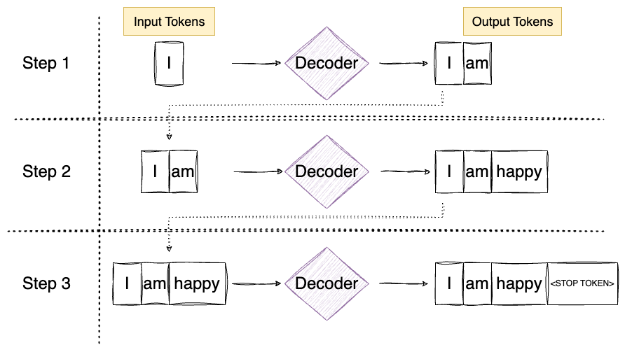
Generative Language Model
Inference with Generative Language Models
We modify the layer to only produce a single output token (return_sequences = False).
We then wrap the new layers with a feedback loop that takes the last prediction and passes it as input to the model again along with the most recent embedding that captures ‘what we’ve done so far’.

Slide 13
Where Did the Encoder Go?
Char-RNN is decoder-only: one RNN, no encoder, no attention. This works because input and output are trivially aligned — predict position t+1 from position t. The hidden state hₜ already encodes everything from characters 1 through t. No need to 'look back.'
Translation is different: input and output are different lengths, vocabularies, and orderings. You must read the whole input before writing any output.
The encoder-decoder split also solved a memory problem with RNN hidden states, which degrade over long sequences. The encoder saves all the input hidden states; attention lets the decoder look back (like Badenhau attention).
Ultimately, the encoder-decoder architecture compensates for RNN limitations, not task requirements. When the task is aligned (shift by 1), a single RNN is both simpler and better. With transformers, even in the case of translation tasks, we no longer need the encoder-decoder architecture (given enough pre-training).

Slide 14
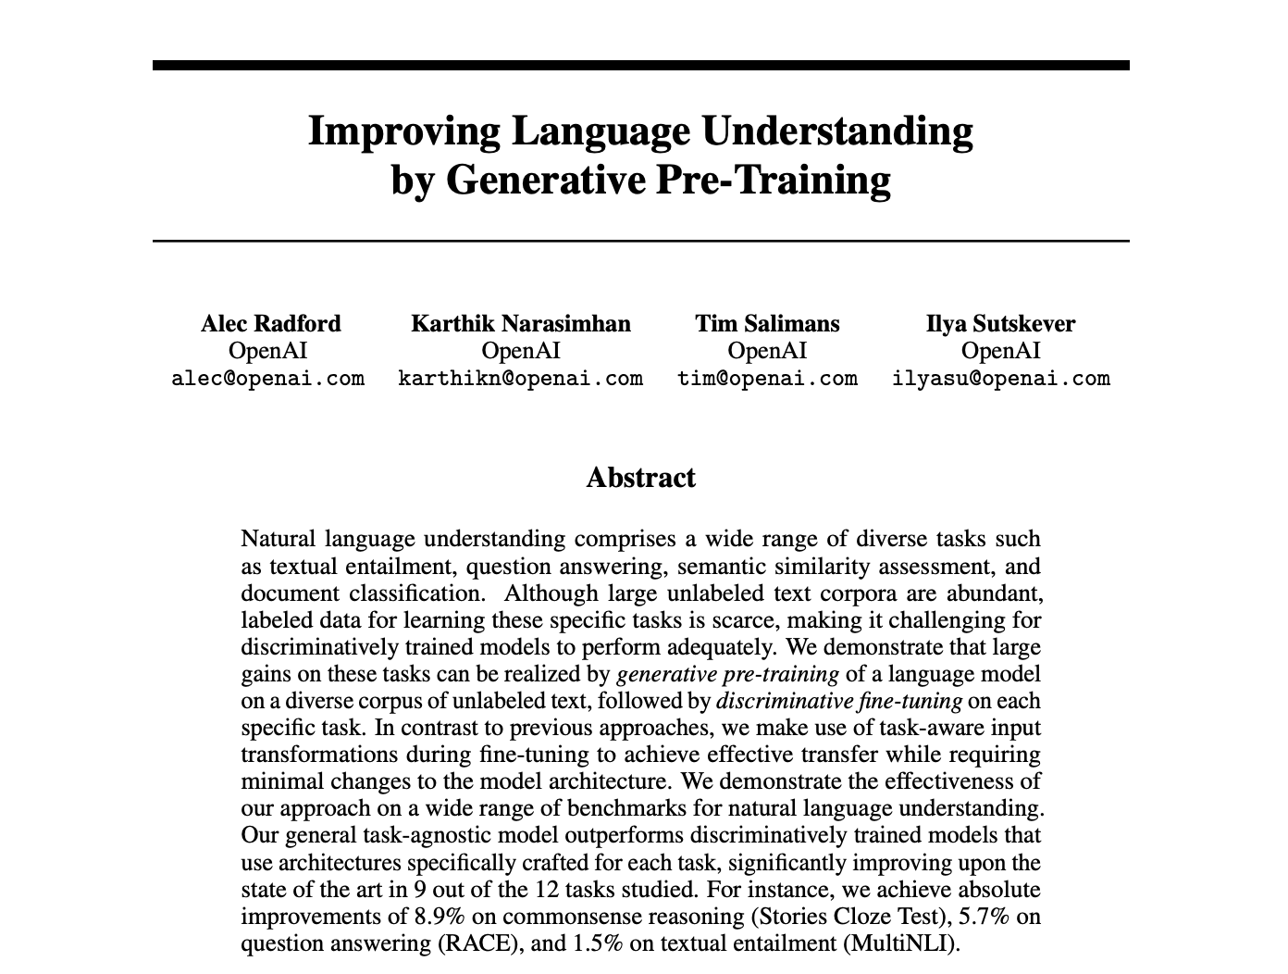
Generative Pre-trained Transformers
Generative Pre-trained Transformers (GPTs)
In 2018, not long after “Attention Is All You Need,” OpenAI put out a paper about the efficacy of scaling data and compute with a mixture of basic ingredients: i) vast amounts of highly varied text, ii) a generative language architecture, and iii) transformers (oh, and RLHF).
GPT-1 (2018) had 117 million parameters trained on 10 million tokens.
GPT-2 (2019) had 1.5 billion parameters and was trained on 10 billion tokens.
GPT-3 (2020) had 175 billion parameters and was trained on 300 billion tokens.

Slide 15

GPTs (and LLMs Generally) Have Many Problems
Various Challenges with LLMs (Among Many Others)
Hallucination: They produce plausible text as output, not necessarily truthful or correct text. Therefore, they are highly dependent on the quality of training data.
Prompt Brittleness: Rewording a prompt even slightly can lead to considerable changes in model response. For example, if you ask the same question of an LLM in different languages, you can get very different answers (conceptually and semantically)!
Memorization: Assessing the performance of LLMs on various task benchmarks is quite challenging because it is often tough to assess whether the model has seen the problem previously and is merely looking up the answer in training data. This affects whether performance reflects how a model might perform on an entirely new task.
Notes:
The host of issues is very extensive. Be careful what intelligence you ascribe to these models, or what you trust them to do.

Slide 16
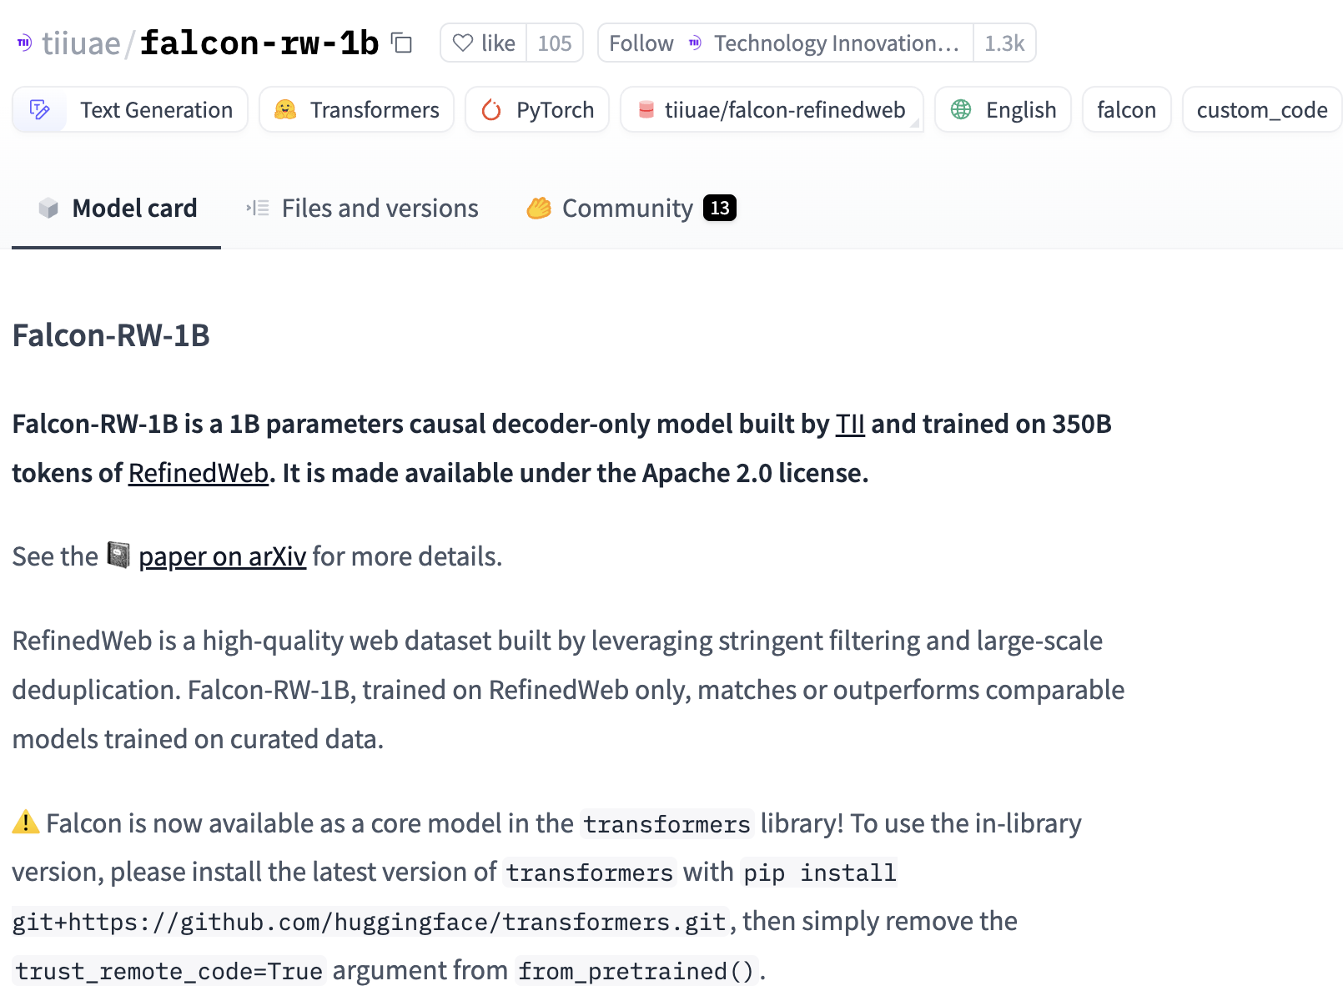
Lots of Pre-Trained LLMs Around
Loading Pre-trained Models from Keras Hub
Check out what is available on the Keras hub. Many open-source and free-to-use models are there, though many are too large for a Colab notebook.
Kaggle hosts some of the models. For a given model, you may need to visit Kaggle and create an API key, complete a request form, or agree to terms and conditions.

Slide 17
Questions?
Notes:
Weights are not initialized until you “build” the model (or compile it, which will first build).

